Slide 1

Cloud Run
Eng. Ismail Anjrini
Notes:
https://cloud.google.com/pubsub/docs/overview

Slide 2



System 1
System 2
System 1
System 2
Gateway
System 1
System 2
Notes:
https://cloud.google.com/pubsub/docs/overview

Slide 3

System 1
System 1
System 2
System 3
System 2
System 3
Notes:
https://cloud.google.com/pubsub/docs/overview

Slide 4
System 1
System 1
System 2
System 3
System 2
System 3
Notes:
https://cloud.google.com/pubsub/docs/overview

Slide 5
What is Pub/Sub?
Pub/Sub is an asynchronous and scalable messaging service
Pub/Sub allows services to communicate asynchronously, with latencies on the order of 100 milliseconds
Pub/Sub enables you to create systems of event producers and consumers, called publishers and subscribers
Publishers send events to the Pub/Sub service, without regard to how or when these events are to be processed

Slide 6
Concepts
Topic
Subscription
Message
Message attribute
Publisher
Subscriber
Acknowledgment (or "ack")
Push and pull

Slide 7
Types of Pub/Sub services
Pub/Sub service
It offers the highest reliability
Pub/Sub guarantees synchronous replication of all data to at least two zones
Pub/Sub guarantees best-effort replication to a third additional zone
Pub/Sub Lite service
It offers lower reliability compared to Pub/Sub
It offers either zonal or regional topic storage
Consider Pub/Sub Lite only for applications where achieving a low cost justifies some additional operational work and lower reliability

Slide 8
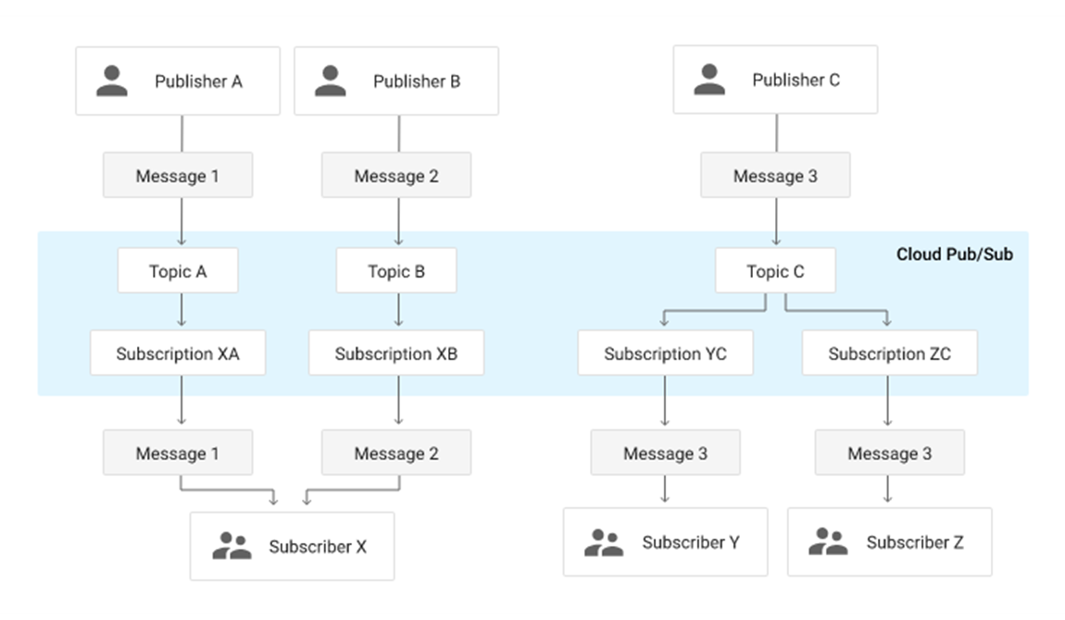

Slide 9
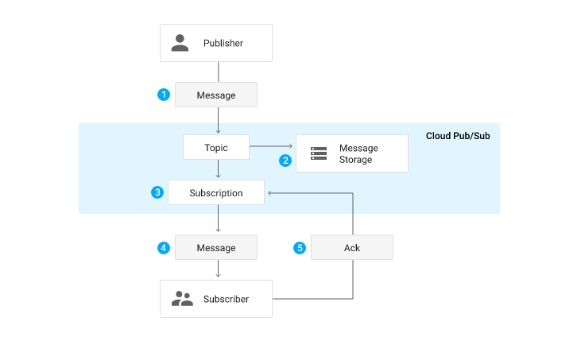

Slide 10
Performance

Slide 11
Scalability
Availability
Latency
Number of topics
Number of publishers
Number of subscriptions
Number of subscribers
Number of messages
Size of messages
Rate of messages (throughput) published or consumed
Size of backlog on any given subscription
Hardware Failure
The amount of time it takes to acknowledge a published message
Human error
Sudden increase in traffic in the service
The amount of time it takes to deliver a published message to a subscriber

Slide 12
Pub/Sub – Create Topic
Eng. Ismail Anjrini
Notes:
https://cloud.google.com/pubsub/docs/overview

Slide 13
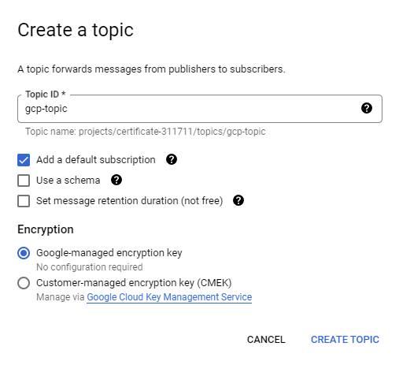
Must be 3-255 characters, start with a letter
letters, numbers, dashes (-), periods (.), underscores (_), tildes (~), percents (%) or plus signs (+)
Cannot start with goog

Slide 14
A subscription with ID "gcp-topic-sub"
Pull delivery type
7 days message retention duration
Expire after 31 days of inactivity
10 seconds acknowledgment deadline
Immediate retry policy

Slide 15
A schema is a format that the message data field must follow
A Pub/Sub schema defines the names and data types of fields in a message
Schemas can be created as standalone versioned resources, associate schemas with multiple Pub/Sub topics
Schema can be created using the Google Cloud console, the gcloud CLI, and the Pub/Sub API

Slide 16
{
"type" : "record",
"name" : "Avro",
"fields" : [
{
"name" : "Name",
"type" : "string"
},
{
"name" : "Active",
"type" : "boolean"
}
]
}

Slide 17
syntax = "proto3";
message ProtocolBuffer {
string Name = 1;
bool Active = 2;
}

Slide 18
Retains messages on the Topic for up to 31 days

Slide 19
Pub/Sub –Subscription
Eng. Ismail Anjrini
Notes:
https://cloud.google.com/pubsub/docs/subscriber

Slide 20
Delivery type
Expiration
Exactly once delivery
Pull
Push
BigQuery
Message ordering
Dead lettering
Retry policy
Message retention
Subscription filter
Notes:
https://cloud.google.com/pubsub/docs/pull

Slide 21




subscription
Gateway
gcp-topic
subscriber
Gateway
subscriber

Slide 22
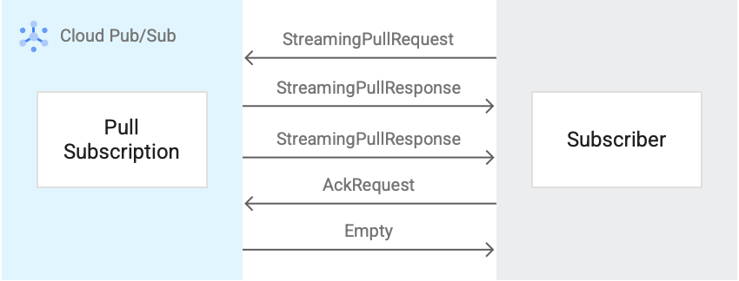

Slide 23
Pub/Sub –Subscription, BigQuery Mode
Eng. Ismail Anjrini
Notes:
https://cloud.google.com/pubsub/docs/subscriber

Slide 24
Delivery type
Expiration
Exactly once delivery
Pull
Push
BigQuery
Message ordering
subscription_name
message_id
Dead lettering
publish_time
data
Retry policy
attributes
Message retention
Subscription filter
Notes:
https://cloud.google.com/pubsub/docs/pull

Slide 25

subscription
Gateway
gcp-topic
Gateway

Slide 26
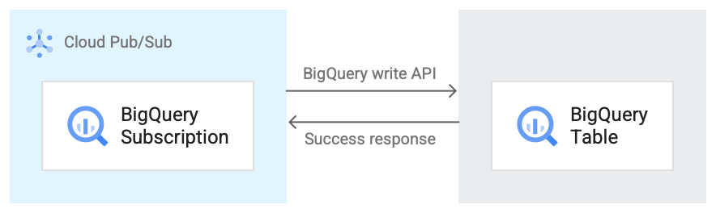

Slide 27
Pub/Sub –Subscription, Push Mode
Eng. Ismail Anjrini
Notes:
https://cloud.google.com/pubsub/docs/subscriber

Slide 28
Delivery type
Expiration
Exactly once delivery
Pull
Push
BigQuery
Message ordering
HTTPS URL
Dead lettering
102
200
201
202
204
Retry policy
Message retention
Subscription filter
Notes:
https://cloud.google.com/pubsub/docs/pull

Slide 29
Gateway
subscription
Gateway
Gateway
gcp-topic
Gateway

Slide 30
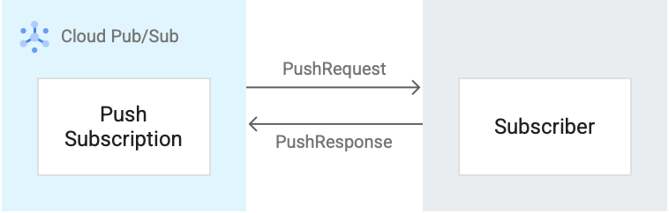

Slide 31
Pub/Sub –Subscription, Message retention
Eng. Ismail Anjrini
Notes:
https://cloud.google.com/pubsub/docs/subscriber

Slide 32
Delivery type
Message retention
Exactly once delivery
Unacknowledged
Acknowledged
Message ordering
Default value = 7 days
Dead lettering
Minimum value = 10 minutes
Maximum value = 7 days
Retry policy
Expiration
Subscription filter

Slide 33
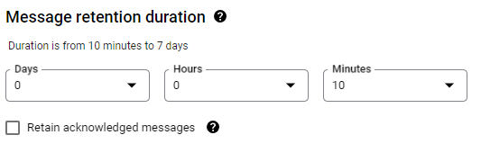

Slide 34
Pub/Sub –Subscription, Expiration
Eng. Ismail Anjrini

Slide 35
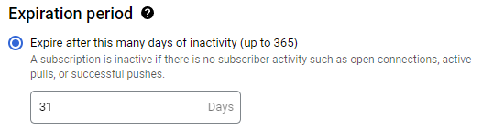
A subscription is inactive if there is no subscriber activity such as open connections, active pulls, or successful pushes
Expire after this many days of inactivity (up to 365)

Slide 36
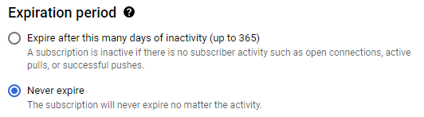
The subscription will never expire no matter the activity

Slide 37
Pub/Sub –Subscription, Acknowledgement
Eng. Ismail Anjrini

Slide 38
Ack
subscription
Gateway
gcp-topic
subscriber
Ack
Gateway
subscriber

Slide 39
Gateway
subscription
Gateway
Gateway
102
200
201
202
204
gcp-topic
Gateway

Slide 40
Success
subscription
Gateway
gcp-topic
Gateway

Slide 41
Acknowledgement deadline is the time from 10 seconds to 600 seconds the Pub/Sub waits for the subscriber to acknowledge receipt before resending the message

Slide 42

Pub/Sub > Retry Policy
subscription
Gateway
gcp-topic
subscriber
Immediate redelivery
Gateway
Exponential backoff

Slide 43
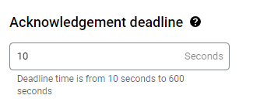

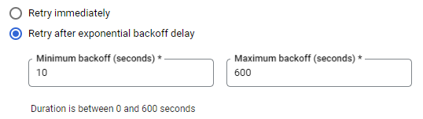

Slide 44
Pub/Sub –Subscription, Dead lettering
Eng. Ismail Anjrini

Slide 45
Pub/Sub > Dead lettering
1
2
3
4
5
subscription
Gateway
gcp-topic
dead
subscriber
Gateway

Slide 46
Pub/Sub –Subscription, Filtering
Eng. Ismail Anjrini
Notes:
https://cloud.google.com/pubsub/docs/subscription-message-filter

Slide 47

subscription
Gateway
gcp-topic
subscriber
Gateway

Slide 48
Filter | Description
attributes:key | Messages with the key attribute
NOT attributes:key | Messages without the key attribute
attributes.key = “log" | Messages with the name attribute and the value of log
attributes.key != “log" | Messages with the name attribute and the value of log
hasPrefix(attributes.key, “log-") | Messages with the name attribute and a value that starts with log-
NOT hasPrefix(attributes.key, “log-") | Messages with the name attribute and a value that starts with log-
NOT AND OR () | Supported operators and parentheses
: = != | Supported comparison operators
attributes.log = "ERROR"
attributes:log

Slide 49
Pub/Sub –Schema
Eng. Ismail Anjrini
Notes:
https://avro.apache.org/docs/1.11.1/specification/_print/

Slide 50



Slide 51

subscription
Gateway
gcp-topic
Gateway

Slide 52
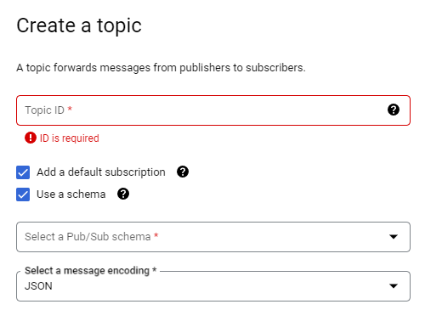

Slide 53
Pub/Sub –Message Ordering
Eng. Ismail Anjrini
Notes:
https://cloud.google.com/pubsub/docs/ordering

Slide 54
5
4
3
2
1
subscription
Gateway
5
4
3
2
1
gcp-topic
subscriber
Gateway

Slide 55
Pub/Sub –Subscription, Cloud Storage Mode
Eng. Ismail Anjrini
Notes:
https://cloud.google.com/pubsub/docs/cloudstorage

Slide 56
subscription
Gateway
gcp-topic
Gateway

Slide 57
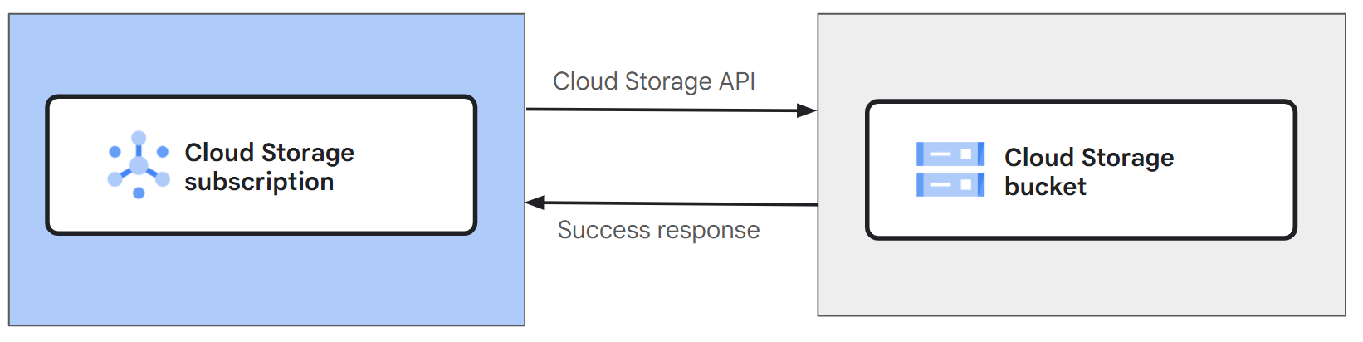

Slide 58
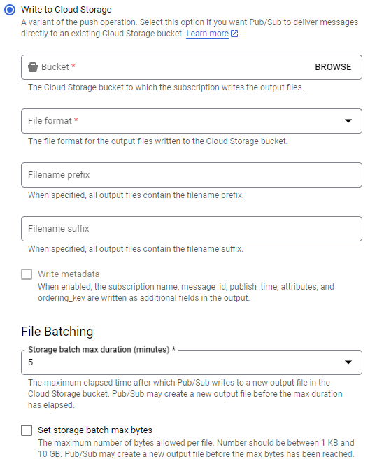

Slide 59
Pub/Sub – local emulator
Eng. Ismail Anjrini
Notes:
https://cloud.google.com/pubsub/docs/emulator

Slide 60
Preparation
Install Google Cloud CLI
gcloud components install pubsub-emulator
gcloud components update
gcloud auth application-default login
Execution
gcloud beta emulators pubsub start --project=PROJECT_ID --host-port=127.0.0.1:8085

